Slide 1
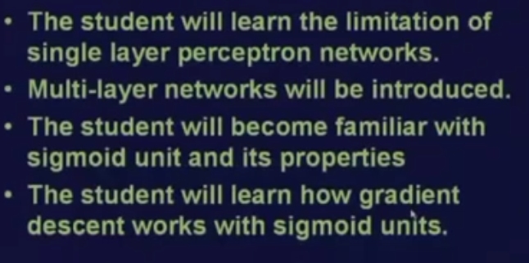

OBJECTIVES OF STUDY OF NEURAL NETWORKS

Slide 2
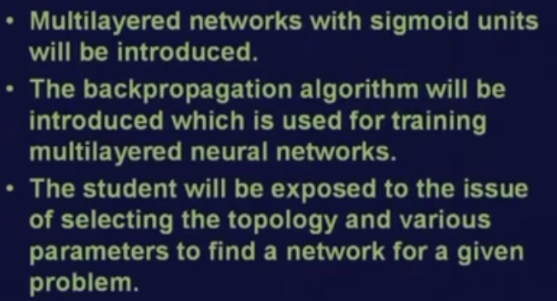
OBJECTIVES OF STUDY OF NEURAL NETWORKS

Slide 3
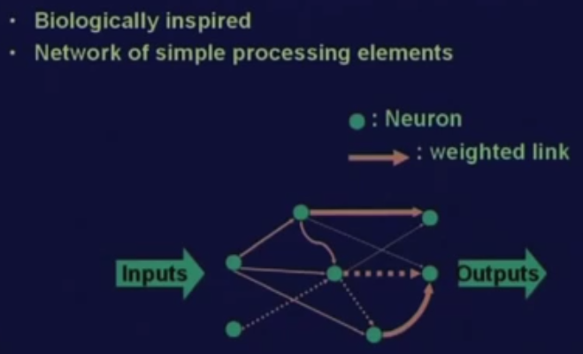
Artificial Neural Network

Slide 4
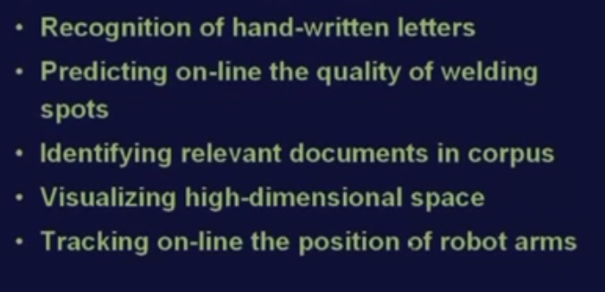
Applications of NEURAL NETWORKS

Slide 5
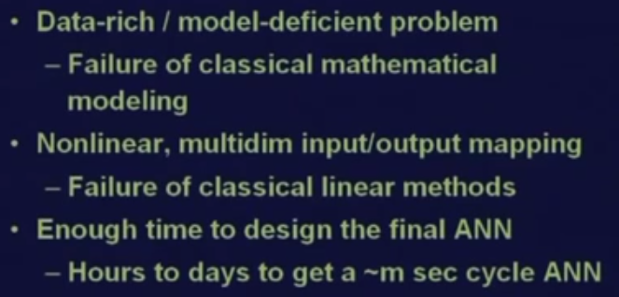
When to Use Neural Networks

